Slide 1

CS411-Compiler Construction
Introduction
Talha Waheed, Dept. of CS, UET, Lahore, Pakistan.

Slide 2
Course Learning Objectives

Slide 3
Introduction and Overview

Slide 4
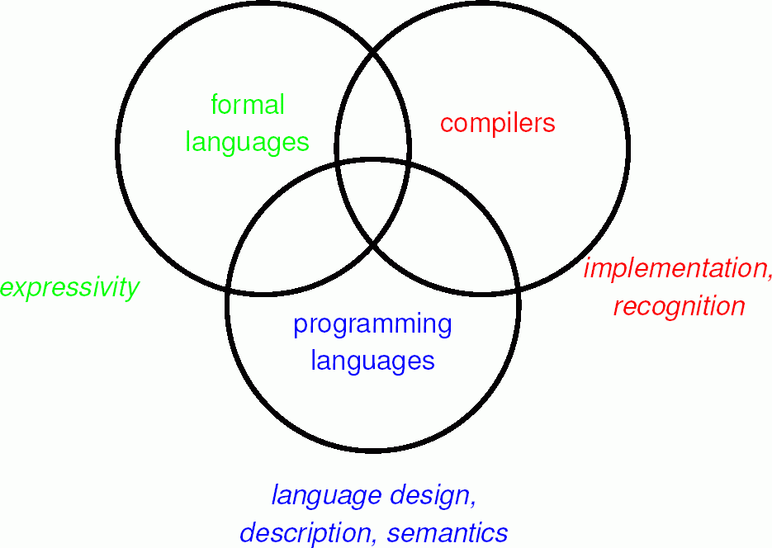
Pre-Requisite Concepts
Core Concepts from
Good Programming skills in a High Level Programming Language
Grip on different Data Structures implementation
Strong background from Theory of Automata
Additional Concepts from
Programming Languages Design
Computer Architecture
Assembly Language
Software Design (e.g. OOAD)
Software Engineering
Algorithm Design

Slide 5


Sotwares and Apps are Everywhere
Now computers and mobile apps are everywhere around us.
Operating Systems: Windows, Android, Linux
Office Automation: MS Office,
Social Media Apps: Whatsapp, Facebook, Instagram
Audio/Video Players, Games, Engineering/ Medical Apps, etc.
All the software applications are written in some programming language.
How many programming languages are there uptil now?
Before a program can be run, it must be translated into a form that can be executed by a computer.

Slide 6
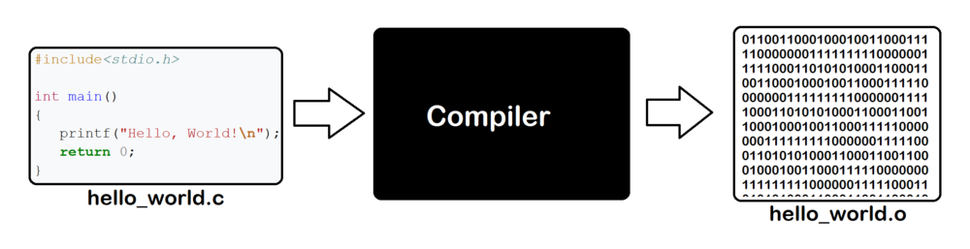
COMPILER
General Definition: A software application that translates a program written in one language or form (i.e. source) into an equivalent program in another language or form (i.e. target).
Source Languages: (General Purpose, Human Oriented) - C/C++, Java, Python, Pascal, Fortran etc … (Special Purpose) – Mathematica, Matlab, Postscript, Tex …
Target Languages: (Machine oriented) Machine Languages of various architectures: intel, amd, raspberry pi, arm
Source Program
( Normally a program written in
a high-level programming language)
COMPILER
Target Program
( Normally the equivalent program in
assembly or relocatable object file)
Error Messages

Slide 7
History
First compiler for arithmetic FORmula TRANslation (Fortran Language) into machine code
Implementation Effort (roughly 6 hours/day * 300 days * 18 years)
Now good formalisms, implementation languages, programming environments and software toolkits are available that makes task very easy
Classifications
On the basis of Functionality
Debugging Compiler, Optimizing Compiler
On the basis of Execution Style
Interpreter vs Compiler
On the basis of structure
Single Pass vs. Multi-Pass (Don’t confuse pass with phases of compiler)

Slide 8
Applications of Compiler in CS
The basic principles and techniques used in compiler design can be applicable to almost every applied area of computer science. E.g.
Techniques used in a lexical analyzer can be used in text editors, information retrieval system, and pattern recognition programs.
Techniques used in a parser can be used in a query processing system such as SQL.
Many software having a complex front-end may need techniques used in compiler design.
A symbolic equation solver which takes an equation as input. That program should parse the given input equation.
Most of the techniques used in compiler design can be used in Natural Language Processing (NLP) systems.

Slide 9
Applications of Compilers
Implementation of High Level Programming Languages
Program Analysis Tools, IDEs
Design of New Computer Architecture
Optimization of Computer Architecture
Software Productivity Tools (CASE Tools, Memory checkers)
Processing XML to generate docs
Natural Language Processing: Translation, Search (Information Retrieval), Document Comprehension, Summary Generation
Automatic Graph Layout (e.g. Graphviz)
Image Processing (Pattern Recognition)
Symbolic equation solver (graph plotting)
Compiler Simulation for Engineering Applications (Matlab simulink)
Implementing a server protocol (http or imap)

Slide 10
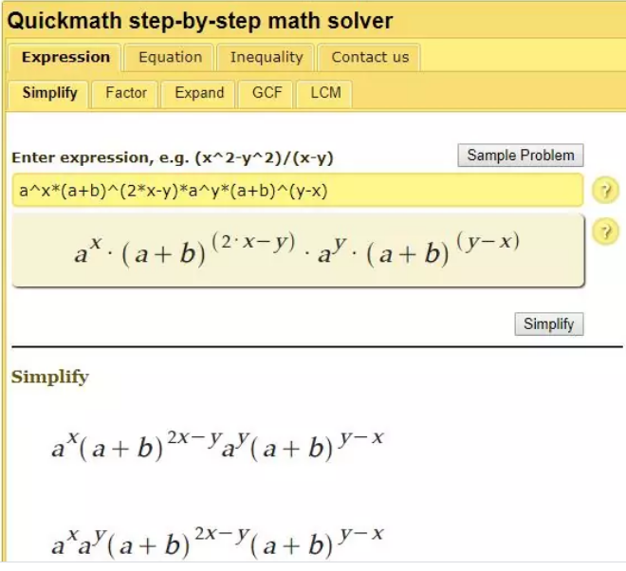
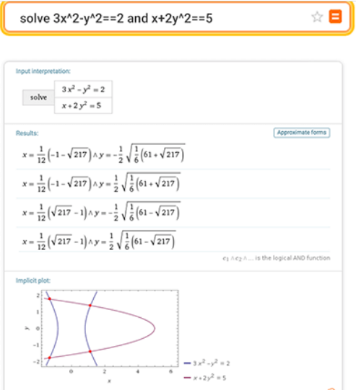
Compiler Applications - Symbolic Equation Solver

Slide 11
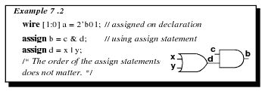
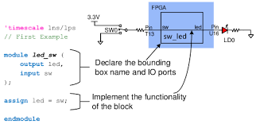
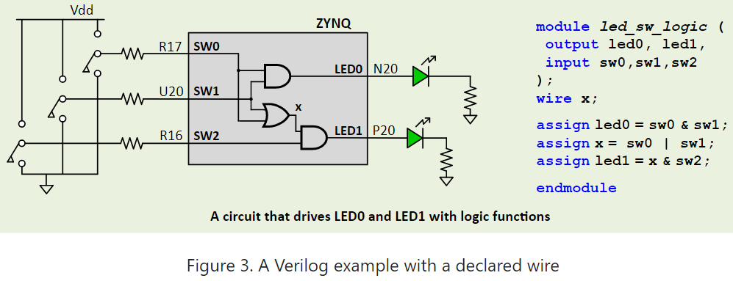
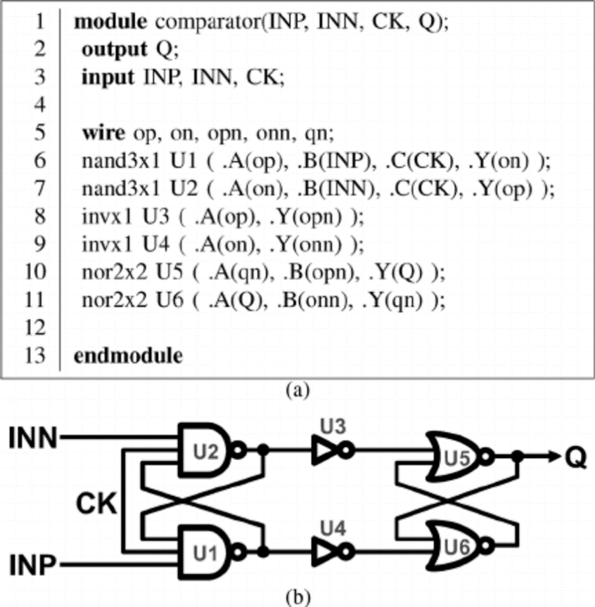
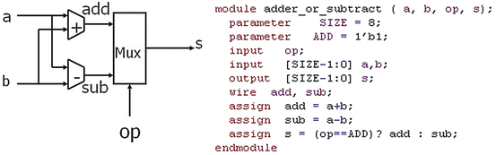
Compiler Applications - Few Verilog Source and Output Examples

Slide 12
Two Major Parts of Compilers
In analysis phase, an intermediate representation is created from the given source program. By going through
Lexical Analyzer,
Syntax Analyzer
Semantic Analyzer
In synthesis phase, the equivalent target program is created from this intermediate representation, by going through
Intermediate Code Generator,
Code Generator,
Code Optimizer

Slide 13
Quick Review - Phases of Compilation
source program
front end
(source)
lexical analyzer
syntax analyzer
semantic analyzer
symbol table
manager
error handler
intermediate
code generator
code optimizer
code generator
back end
(target)
target program
Each phase transforms the source program from one representation
into another representation.

Slide 14
Overall Context of Compiler in a Language Processing System
skeletal source program
preprocessor
modified source program (character stream)
lexical analyzer
front end
(source)
token stream
syntax analyzer
syntax/parse tree
semantic analyzer
annotated syntax tree
Intermediate code generator
intermediate representation
symbol table
manager
Machine independent code optimizer
error handler
intermediate representation
code generator
target machine code
target machine code
Machine dependent code optimizer
Library files/ relocatable obj files
back end
(target)
target assembly program
Relocatable machine code
assembler
loader/linker

Slide 15

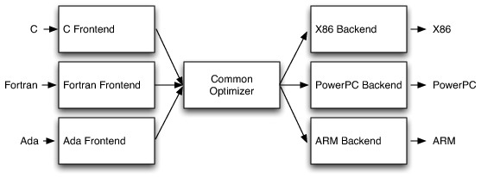
Modern Compilers Implementation
Traditional Compilers Implementation
For each language and for each architecture we need a separate compiler,
For M languages and for N architectures we require M*N compilers
Three Major components of 3 phase compiler developed by different vendors
M+N compilers
M High Level Languages
N Architectures

Slide 16
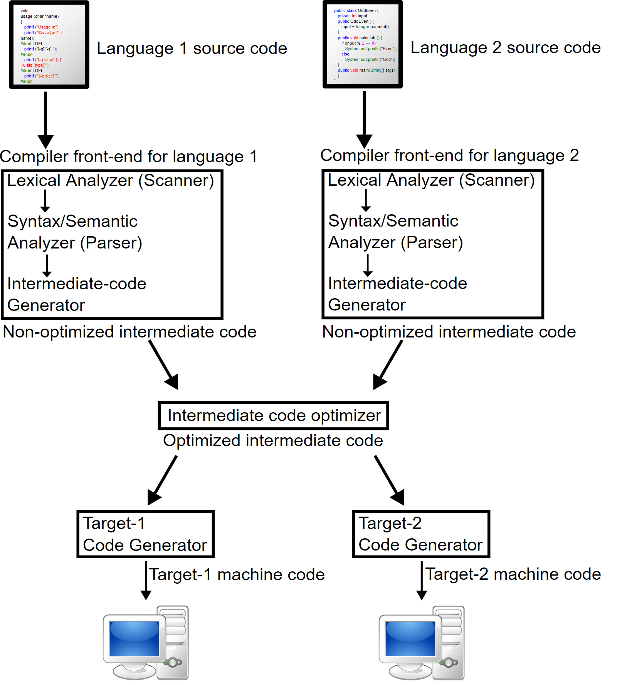
Modern Compilers

Slide 17
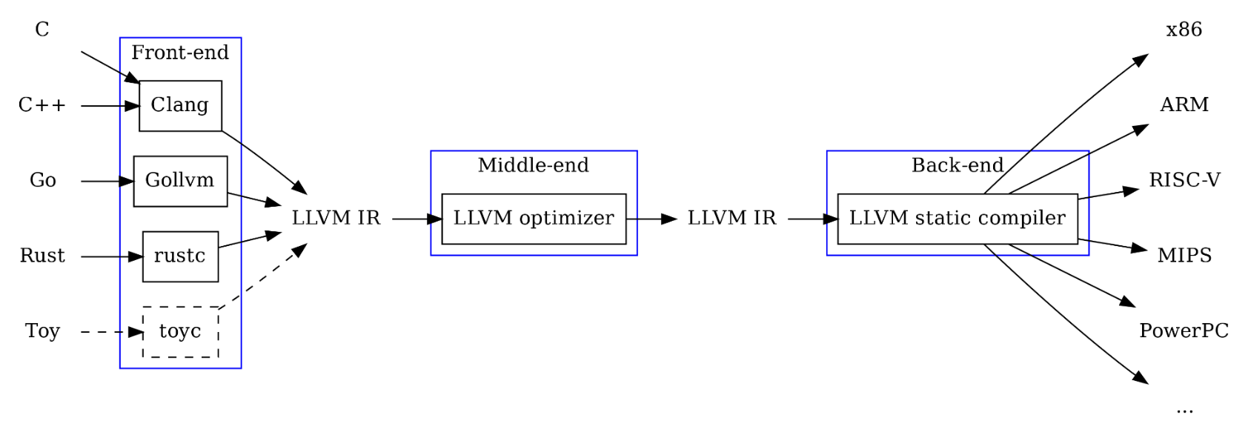
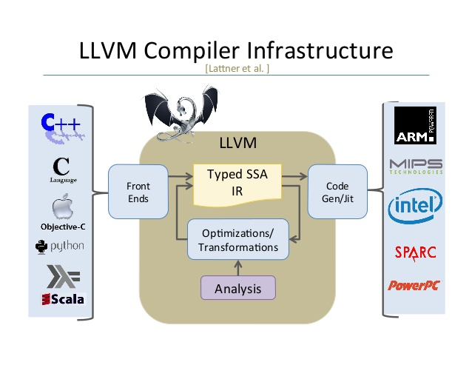
LLVM Project by University of Illinois at Urbana Champaign
A collection of modular and reusable compiler and toolchain technologies
SSA: Each variable be assigned exactly once, and every variable be defined before it is used

Slide 18
Lexical Analyzer
Linear scan of source program for grouping the characters into word and then classification of the words into types (tokens)
Store extracted information about identifiers, arrays, functions and constants into the symbol table.
Regular expressions/Regular Grammars are used to specify the tokens (that are lexical constructs).
A (Deterministic) Finite State Automaton (or its variants) can be used for implementing a lexical analyzer, to recognize tokens.

Slide 19
Tokens
A token describes a pattern of characters having same meaning in the source program. (such as identifiers, operators, keywords, numbers, delimeters and so on)
The set of all valid tokens in a programming language is a formal language that is regular and can be defined using regular expression.
Some Tokens in (Pascal)
Operators + - := ;
Keywords if end while
Integers 191
Real 3.14
String ‘Tom’
Identifier myVariable
Example Input (assignment statement) newval := oldval + 12;
Word/Lexeme Token
newval Identifier
:= Assignment operator
oldval Identifier
+ Add operator
12 Number
; Terminator

Slide 20
Syntax Analyzer
A Syntax Analyzer creates the syntactic structure (generally a parse tree) of the given statements.
A syntax analyzer is also called as a parser (parsing means to check whether the input is generated from the grammar rules).
A parse tree describes a syntactic structure of a statement.
The syntax of a language is typically specified by a context free grammar (CFG).
The rules in a CFG are mostly recursive.
So a syntax analyzer checks whether a given program satisfies the rules implied by a CFG or not.
If it satisfies, the syntax analyzer creates a parse tree for the given program.
Otherwise give an error.

Slide 21
Syntax Analyzer (A CFG Example)
AsgnStmt → identifier := expression ;
expression → identifier
expression → number
expression → - expression
expression → (expression)
expression → expression operator expression
operator → + | - | * | /
number → 0 | 1 | .. | 9

Slide 22
Syntax Analyzer
Input:
newval := oldval + 12 ;
String Token
newval identifier
:= assignment operator
oldval identifier
+ add operator
12 a number
; Terminator
Parse Tree of Input:
AsgnStmt
identifier := expression
newval expression + expression
identifier number
oldval 12
;
Derivation of Input: AsgnStmt ➔ identifier := expression; ➔ newval := expression; ➔ newval := expression + expression; ➔ newval := identifier + expression; ➔ newval := oldval + expression; ➔ newval := oldval + number; ➔ newval := oldval + 12;
In a parse tree, all terminals are at leaves.
All inner nodes are non-terminals in a context free grammar.
Compiler may or may not explicitly build the tree while parsing

Slide 23
Lexical Analyzer vs Syntax Analyzer
Specifier: Regular expressions
Unit of Analysis: Lexemes/ Words
The lexical analyzer works on the smallest units (characters) in a source program to recognizes valid tokens in a source program.
Deals with simple non-recursive constructs of the language (i.e. words).
The lexical analyzer simplifies the job of the syntax analyzer.
Specifier: Context free Grammar
Unit of Analysis: Statements/ Sentences
The syntax analyzer works on the smallest units (tokens) in a source program to recognize valid statements in a source program.
Deals with recursive constructs of the language (i.e. statements).

Slide 24
Parsing Techniques
Depending on how the parse tree is created, there are different parsing techniques.
Most famous parsing techniques are categorized into three groups:
Top-Down Parsing, Bottom-Up Parsing, Universal Parsing
Top-Down Parsing:
Construction of the parse tree starts at the root, and proceeds towards the leaves.
Efficient top-down parsers can be easily constructed by hand.
Recursive Predictive Parsing, Non-Recursive Predictive Parsing (LL Parsing).
Bottom-Up Parsing:
Construction of the parse tree starts at the leaves, and proceeds towards the root.
Normally efficient bottom-up parsers are created with the help of some software tools.
Bottom-up parsing is also known as shift-reduce parsing.
A kind of shift reduce is Operator-Precedence Parsing – simple, restrictive, easy to implement
LR Parsing – much general form of shift-reduce parsing, CLR, SLR, LALR

Slide 25
Symbol Table Management
Symbol table is a data structure (2d array, map, tree etc) used by all phases of the compiler to keep track of user defined symbols as well as keywords.
During early phases (lexical and syntax analysis) symbols and their information are discovered and put into symbol table
During later phases symbols are looked up from symbol table to validate their usage.

Slide 26
Symbol Table

Slide 27
Semantic Analysis
Syntax vs Semantics?
Syntax is how to write a statement (form/rule).
Semantics is what does a statement means.
Involves examining the syntax output for correct semantic usage
type checking
flow of control checks
uniqueness checks (of identifiers, case labels, etc.)

Slide 28
Semantic Analyzer
A semantic analyzer checks the source program for semantic errors and collects the type information for the code generation.
Type-checking is an important part of semantic analyzer.
Normally semantic information cannot be represented by a context-free language used in syntax analyzers.
Context-free grammars used in the syntax analysis are integrated with attributes (semantic rules)
the result is a syntax-directed translation,
Attribute grammars
Ex:
newval := oldval + 12
The type of the identifier newval must match with type of the expression (oldval+12)

Slide 29
Error Handling
Errors can occur at all phases in the compiler
Invalid linear combinations in lex,
missing semicolon is a syntax errors,
Type mismatch is a semantic error, etc.
Good compilers will attempt to recover from errors and continue

Slide 30
Intermediate Code Generation
Rather than generating code for a specific architecture, most compilers generate to intermediate language
Retargeting for different architecture is facilitated
Machine-independent code optimization can be applied
Code generation for different source languages can be combined as we have seen in LLVM
Can be interpreted at this point

Slide 31
Intermediate Code
Intermediate code is generally in 3-address type format
newval := oldval * fact + 1
id1 := id2 * id3 + 1
MULT id2,id3,temp1
ADD temp1,#1,temp2
MOV temp2,id1

Slide 32
Optimization
Intermediate code is examined and optimized
Can be as simple as combining adjacent statements to reorganizing data for cache efficiency
Can make orders of magnitude difference in the execution speed of generated code

Slide 33
Code Optimizer (for Intermediate Code Generator)
The code optimizer optimizes the code produced by the intermediate code generator in terms of time and space.
MULT id2,id3,temp1
ADD temp1,#1,temp2
MOV temp2,id1
MULT id2,id3,temp1
ADD temp1,#1,id1

Slide 34
Code Generation
Generation of real executable code for a particular target architecture
Output can either be assembly code for target architecture requiring assembler / or object code ready for linking

Slide 35
Target Code Generator
Produces the target code for a specific architecture.
The target program is normally a relocatable object file containing the machine codes.
Machine Independent
Machine Specific
MULT id2,id3,temp1
ADD temp1,#1,id1
MOVE id2,R1
MULT id3,R1
ADD #1,R1
MOVE R1,id1

Slide 36
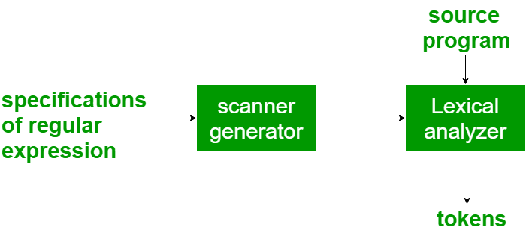
Compiler Construction Toolkits
A Number of Tools exist to help in the development of some stages of the compiler e.g.
Scanner Generator – Lex, Flex. It generates lexical analyzers from the input (in regular expressions) based on tokens of a language. It generates code for a finite automaton to recognize the regular expression.
Lex is a unix utility since early 70’s.
It takes a specification for tokens/patterns of a language as a source
And generates a C lexical analyzer program.

Slide 37
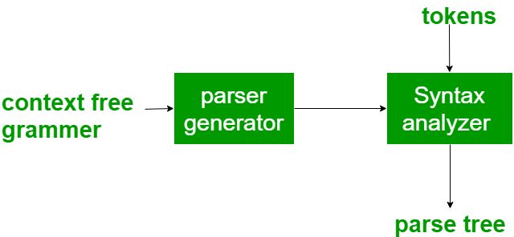
Compiler Construction Toolkits
Parser Generator – Yacc, Bison. Generates parsers from the input that is based on a grammatical description of programming language (a CFG).
Syntax Directed Translator - It generates intermediate code (in 3-address format) from the input that consists of a parse tree. These engines have routines to traverse the parse tree and then produces the intermediate code. In this, each node of the parse tree is associated with one or more translations.

Slide 38
Compiler Construction Toolkits
Automatic Target Code Generator - It generates the machine language for a target machine. Each operation of the intermediate language is translated using a collection of rules and then is taken as an input by the code generator. A template matching process is used. An intermediate language statement is replaced by its equivalent machine language statement using templates.
Data-flow Analyzer - It is used in code optimization. Data flow analysis is a key part of the code optimization that gathers the information, that is the values that flow from one part of a program to another.
Compiler Construction Toolkits – Cocktail, ELI, GENTLE, PCCTS. A compiler design prototyping suite that has an integrated set of routines that aids in building compiler components or in the construction of various phases of compiler.

Slide 39
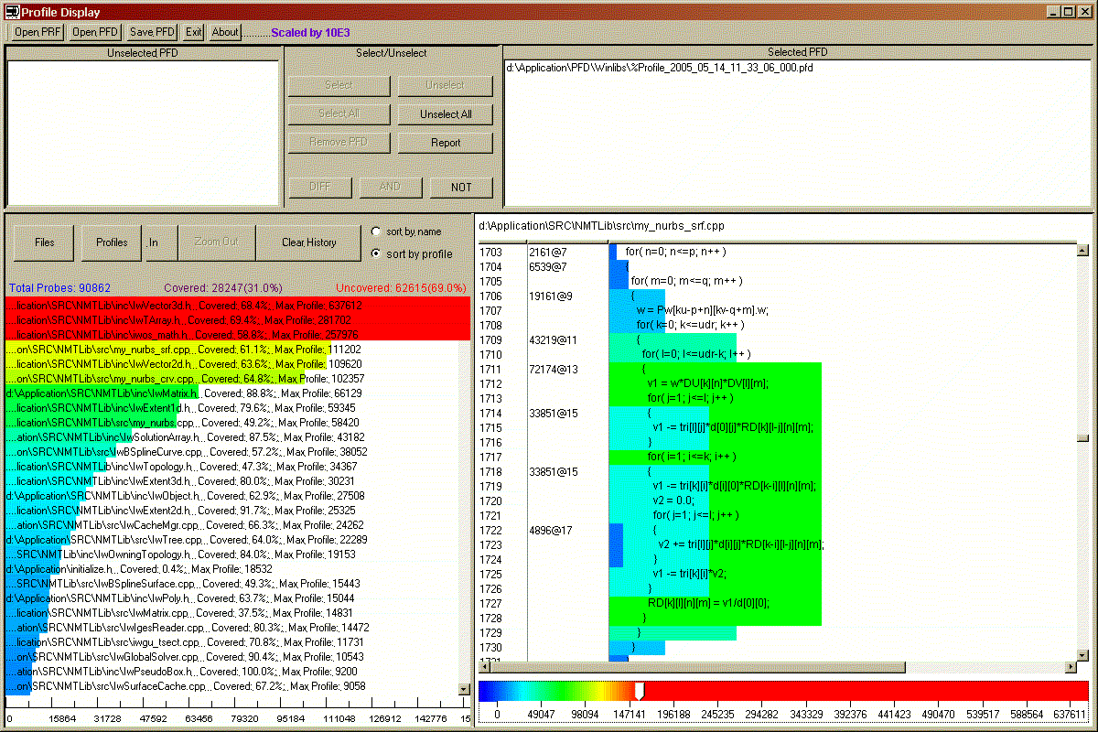
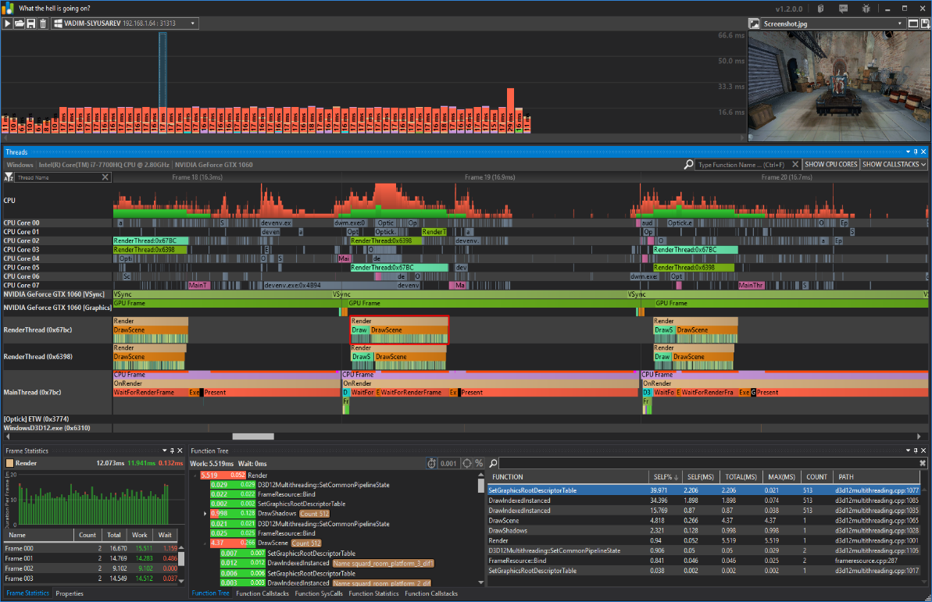
C++ Profiler Tool
A form of dynamic program analyzer that measures, e.g., space or time complexity of a program, usage of particular instructions, or the frequency and duration of function calls.
The Semantic Design C++ Profiler tool enables collection and display of execution profile data on C++ software source code bases of arbitrary size. It Provides execution counts on basic blocks, or timing profiles on methods.
http://www.semdesigns.com/Products/Profilers/CppProfiler.html
Optick is a C++ profiler for Games.
It provides access for all the necessary tools required for efficient performance analysis and optimization: instrumentation, switch-contexts, sampling, GPU counters.
https://github.com/bombomby/optick

Slide 40
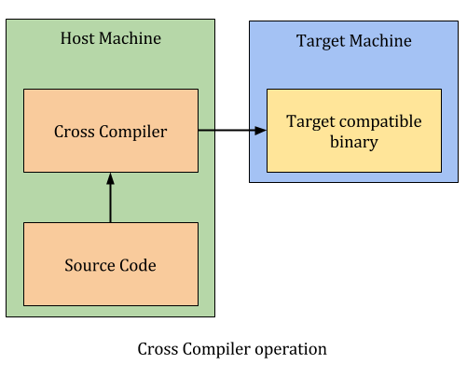
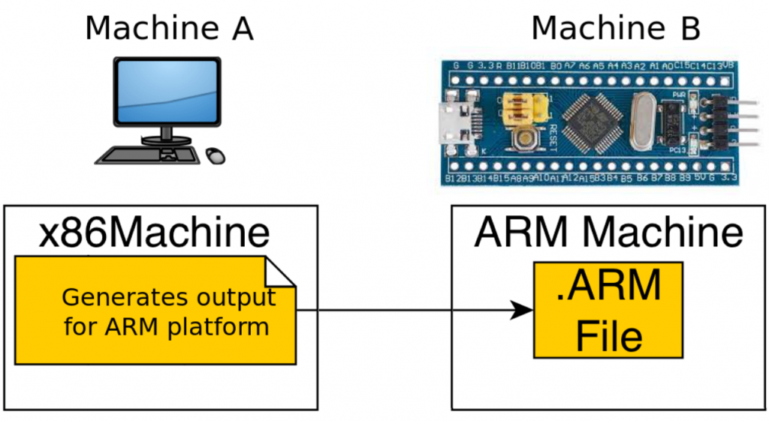
Cross Compiler
3 Types of Compilers – Native, Source to Source, Cross Compiler
A cross compiler is a compiler capable of creating executable code for a platform other than the one on which the compiler is running

Slide 41
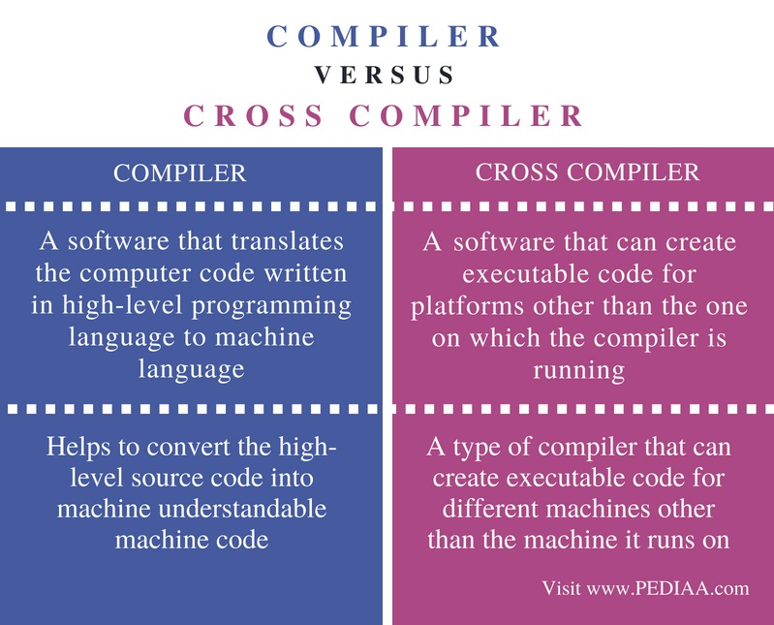

Slide 42


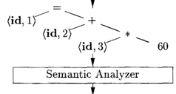
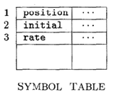
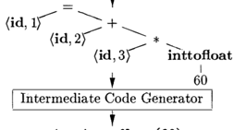
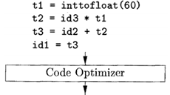


Translation of an Assignment Statement
Input
Output

Slide 43
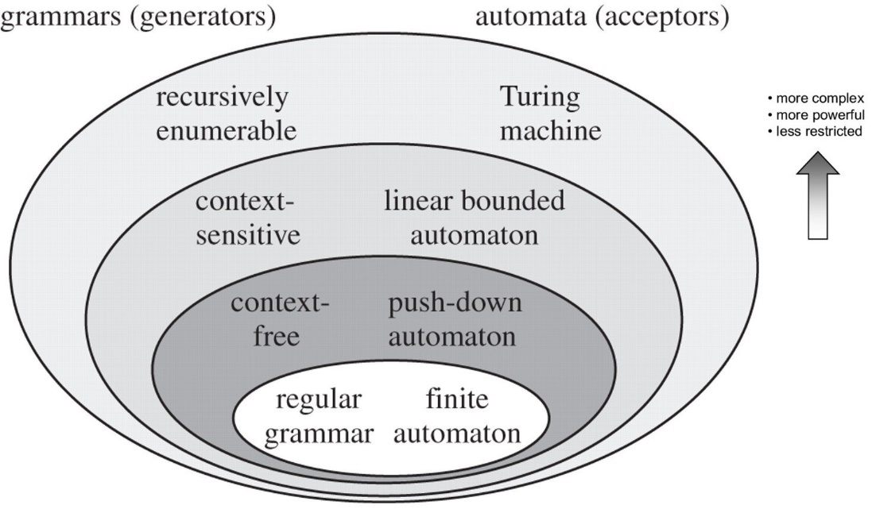
Chomsky Hierarchy of Formal Languages

Slide 44
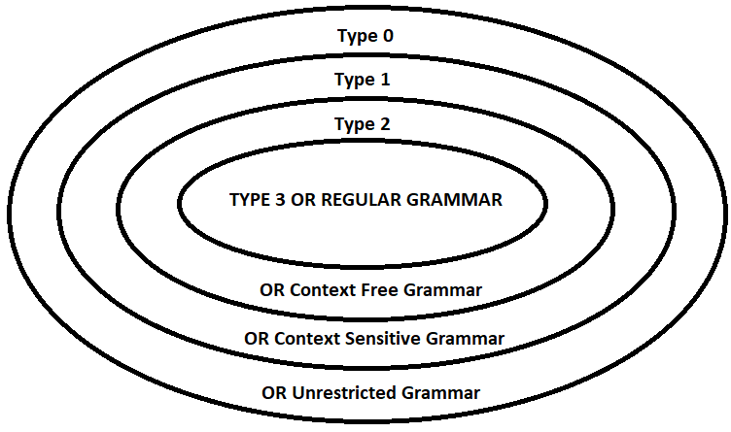
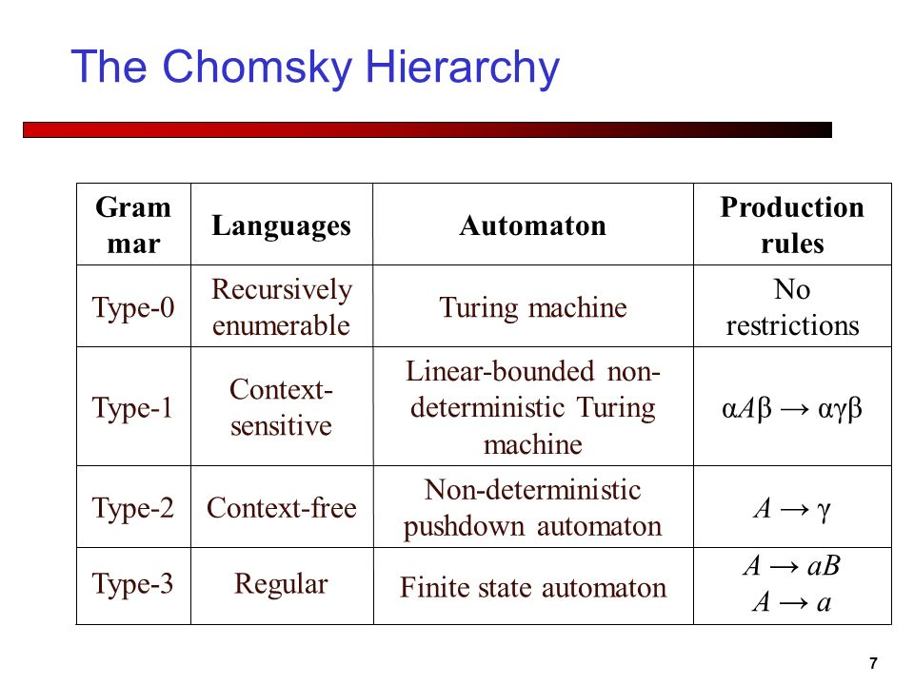
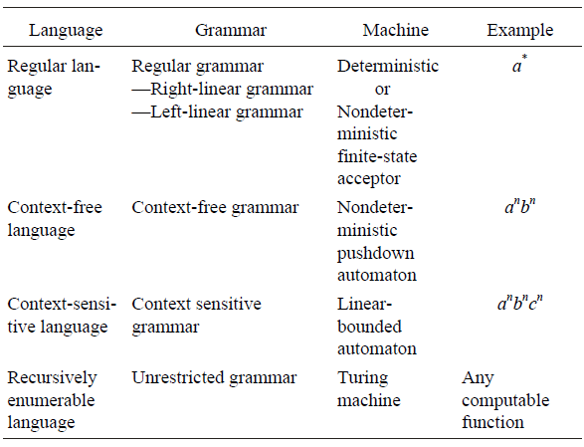
Grammars
Chomsky Hierarchy binds Grammars, Languages, and Automatons

Slide 45
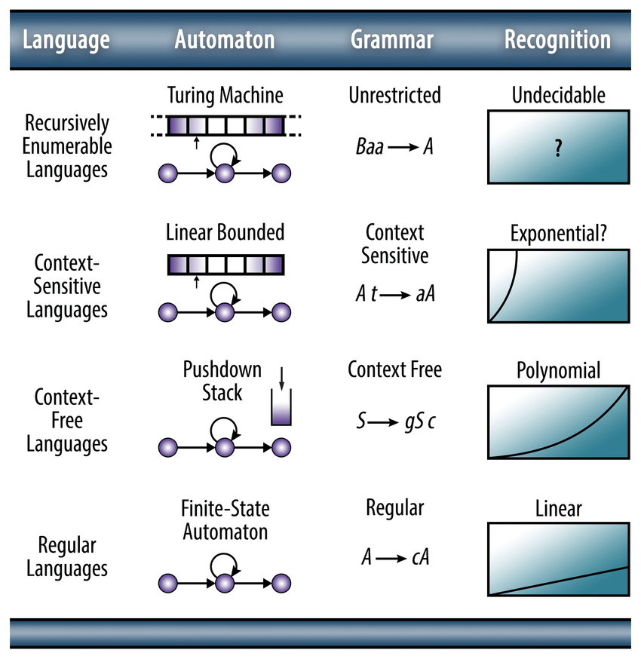
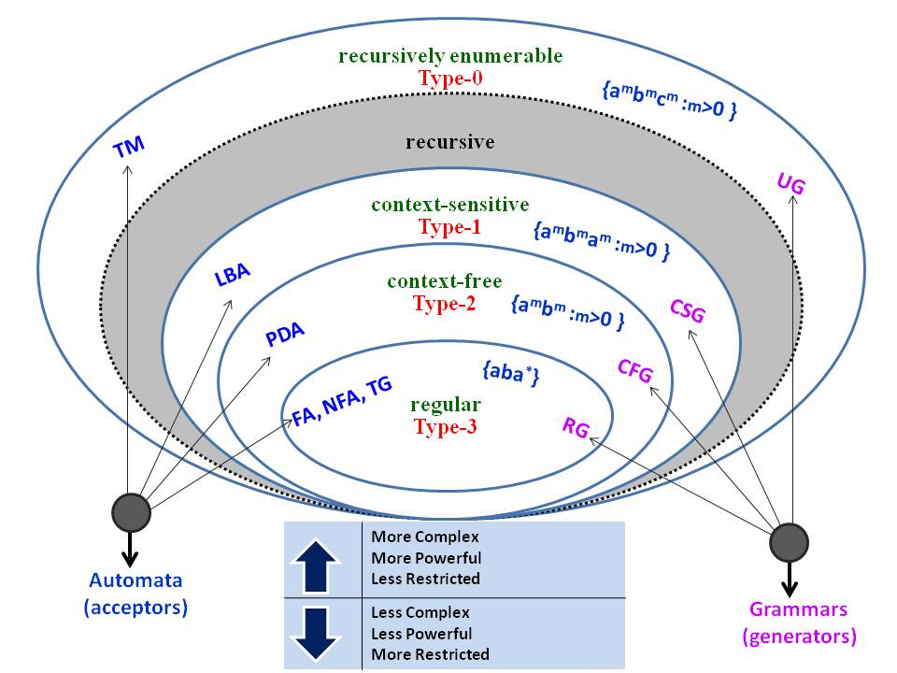

Slide 46
Compilation Phases and Chomsky Hierarchy
Language | Generator | Acceptor | Compilation Phase
Regular | Regular Grammar/Expression | Finite Automata | Lexical Analysis
Context Free | CFG | Pushdown Automata | Syntax Analysis
Context Sensitive | CSG | LBA | ??
Type 0 Languages | Type 0 Grammar | Turing Machine (Algorithm) | ??

